Slide 1
Team 1: Infinite Focus midterm review
Software Engineering Project
March 22, 2024

Slide 2
Project overview
Build solution that helps users avoid doom scrolling
Composed of:
- React Chrome extension that freezes browsing and triggering tasks
- React Web portion where users can set preferences & complete tasks
- React Native mobile portion that operates the same as on web
1

Slide 3
System architecture
Frontend
Backend
Extension
Mongo DB
Server
Web
Mobile
2

Slide 4
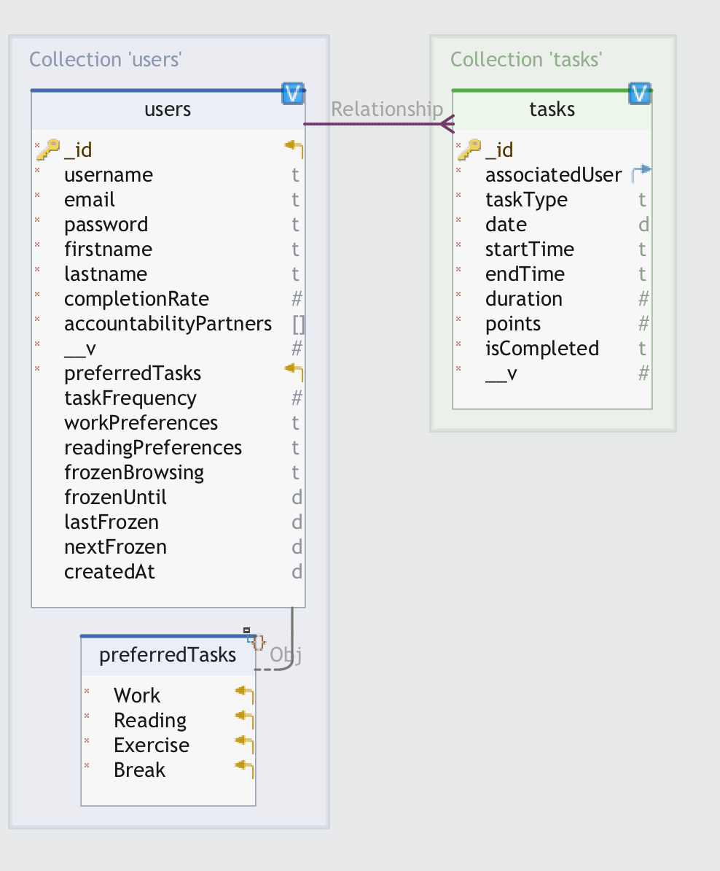
Database structure
4
Notes:
MongoDB stores unstructured data faster than MySQL since there is no requirement to define schema beforehand. The data read and write process is also quicker since all information for each entity is stored in a single document.
The MS SQL server does not accommodate large amounts of data, however MongoDB does.

Slide 5
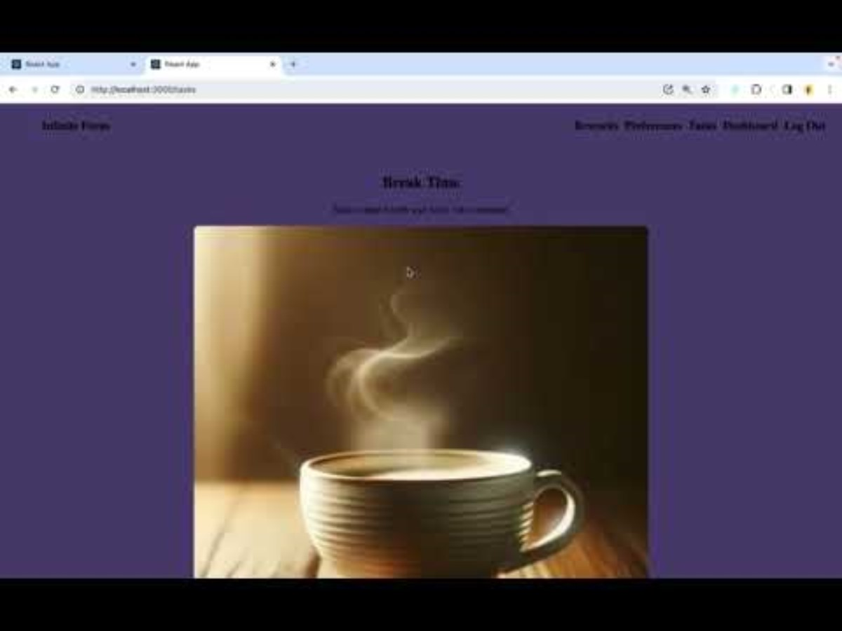
Demo
4

Slide 6
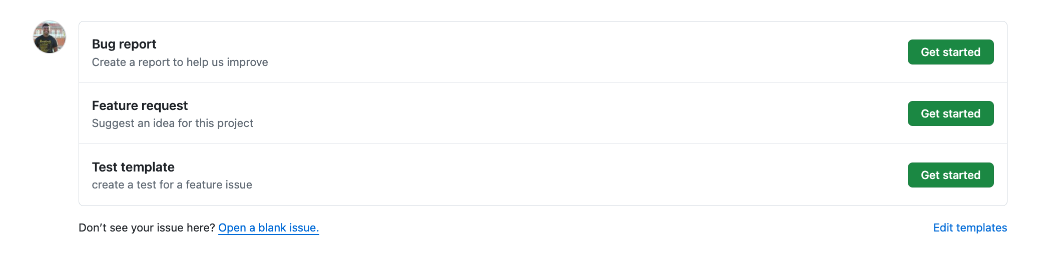
Planning
Meet at the end of sprints to discuss points for features
Grade issues using the Fibonacci sequence
Before starting an issue, comment on it
Comment on the issue when finished and tag someone to verify that it's done
No code merged without the corresponding test
5

Slide 7
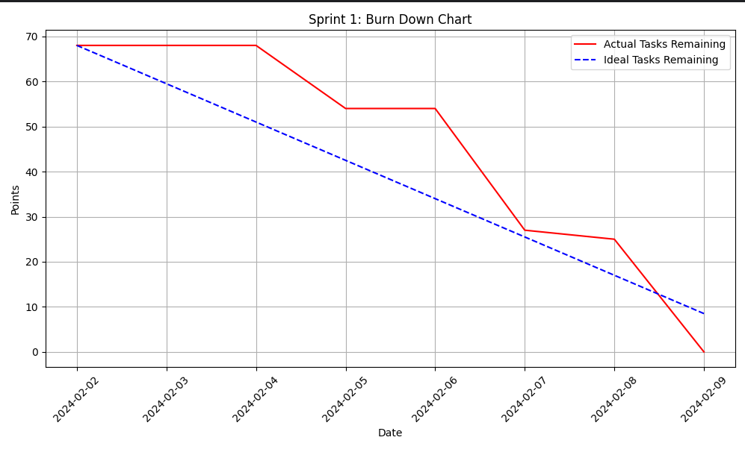
Burndown: Sprint 1
69 points completed
6

Slide 8
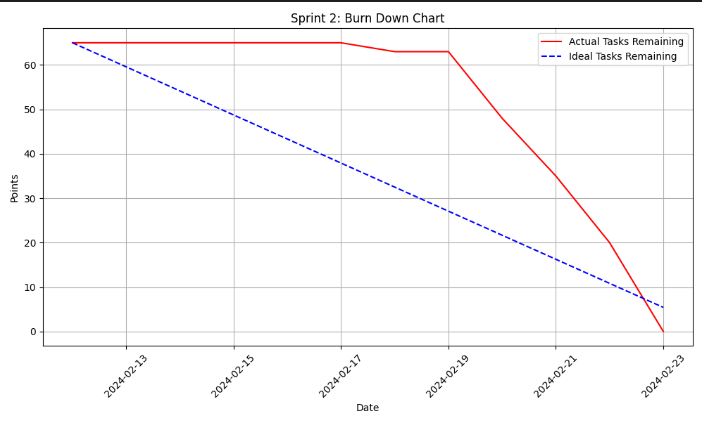
Burndown: Sprint 2
70 points completed
Slow start due to focus on test plan presentations & difficult issues
7

Slide 9
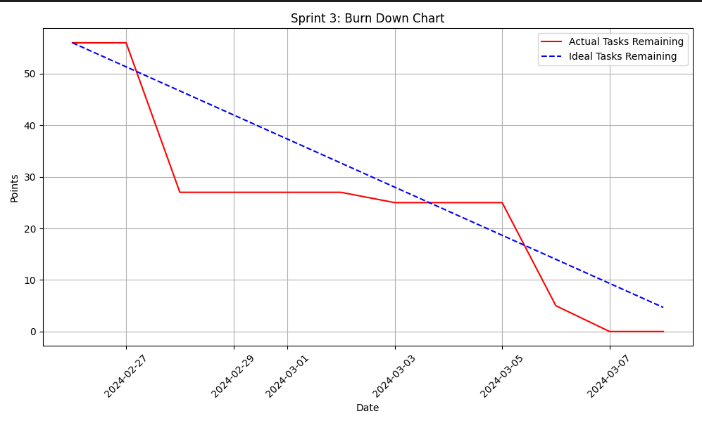
Burndown: Sprint 3
63 points
Forgetting to close the finished issue
8

Slide 10
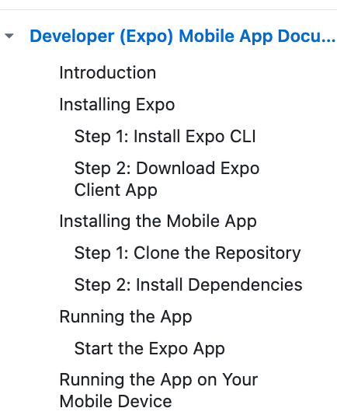
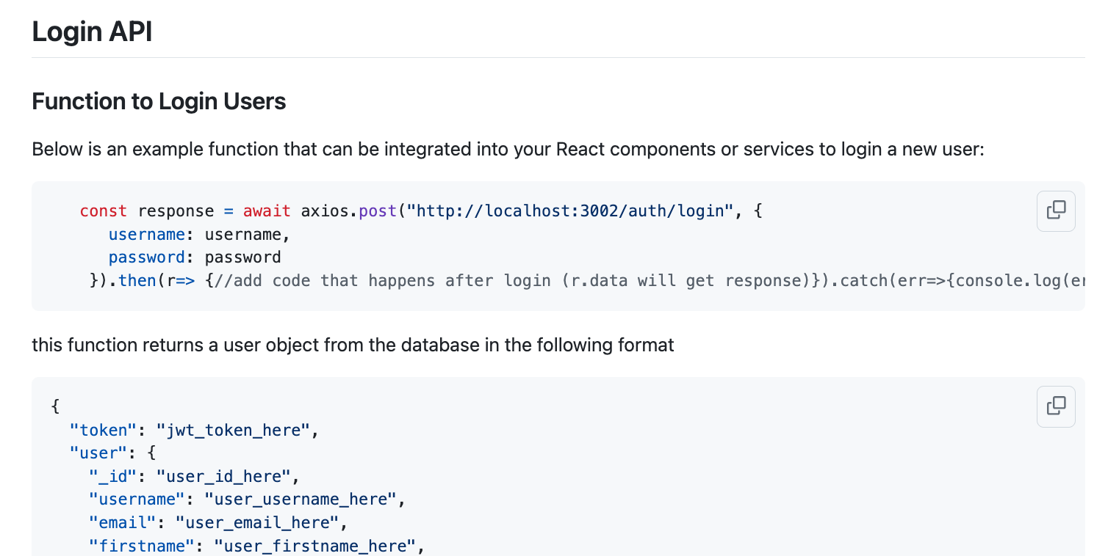
Communication
3 Weekly meetings to discuss pressing tasks and updates
Microsoft teams
Developer docs in wiki
9

Slide 11
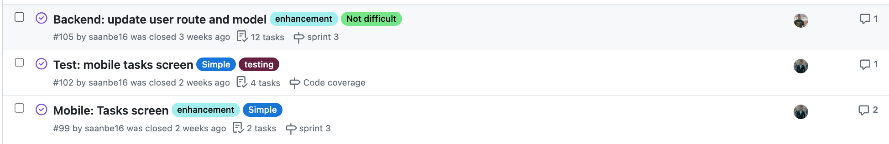
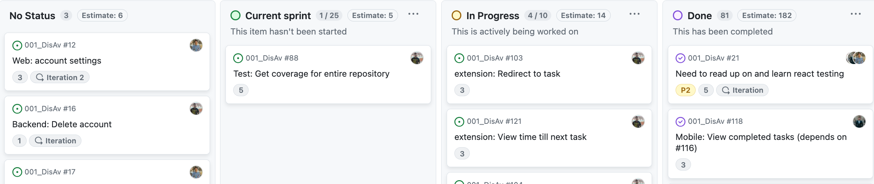
Project Management
10

Slide 12
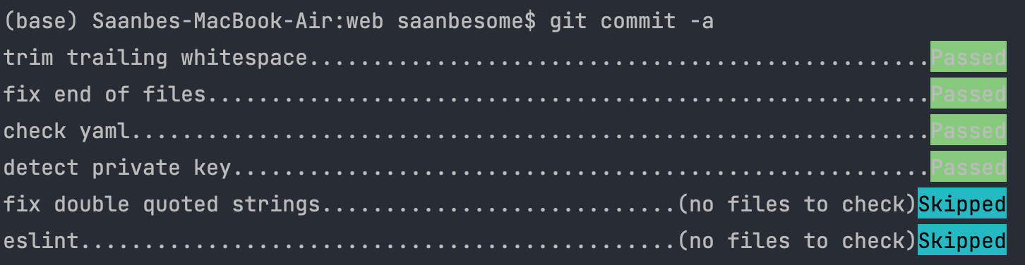
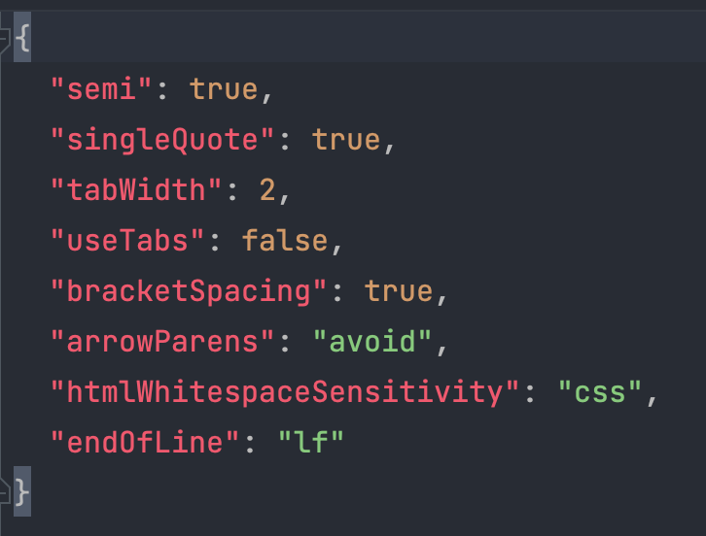
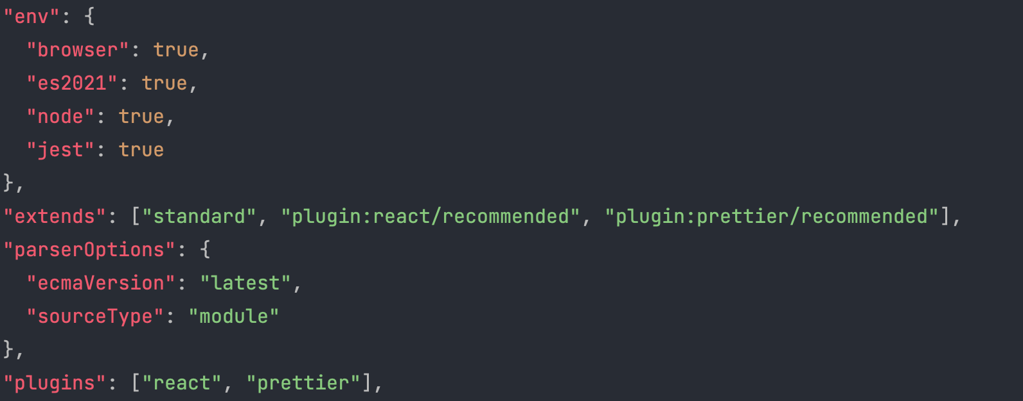
Code consistency
Pre-commit config
Prettier config
Eslint Config
11

Slide 13
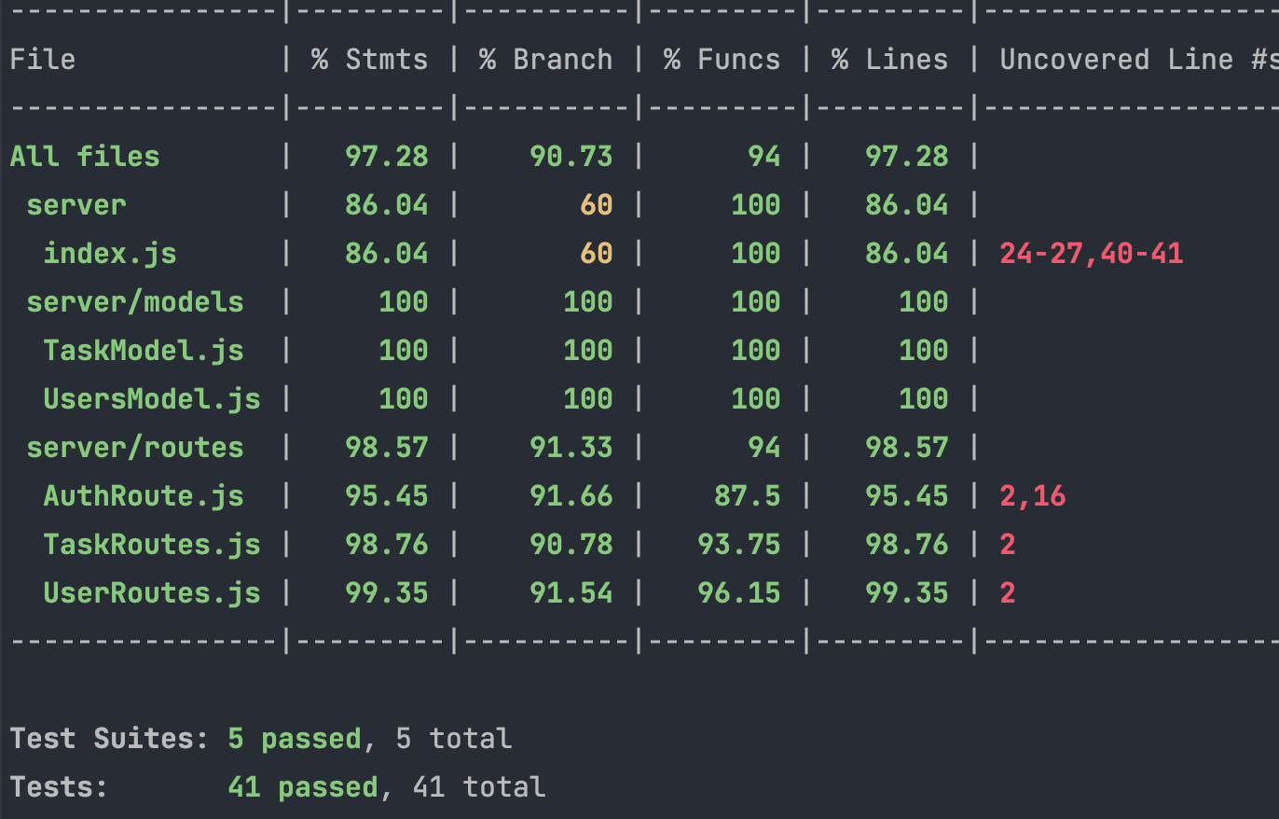
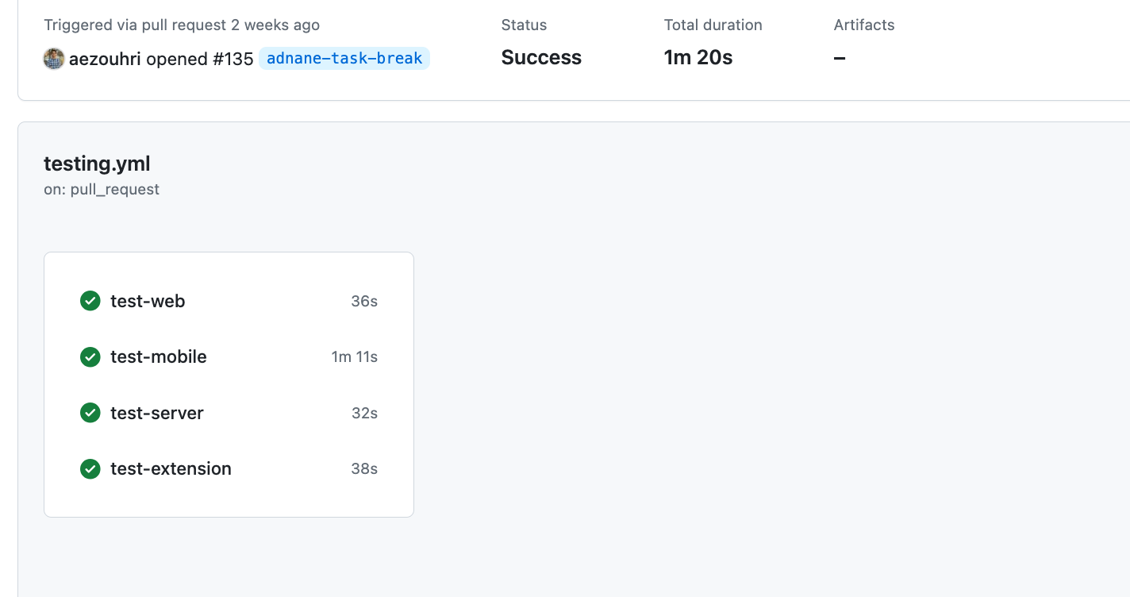
Testing
Over 100 total unit & regression tests
Total Code coverage across projects above 85%
CI using GitHub actions on PR
12

Slide 14
Retrospective
Difficulties/ Short comings
Successes
Sporadic coding
Overlapping work (at start)
Documenting bugs when found
Working MVP with break task
Frequent meetings and good communication
Activity in issues & pull requests
Successful testing strategy
13

Slide 15
Next steps
Develop tasks for reading & exercise
Check current user tab for entertainment/work
Create accountability system
Design badges and points system
Improve & homogenize UI throughout project
14

Slide 16
Questions?

